Slide 1
UNIT 3 8 Hrs
Programming timers 0 and 1 in 8051 C, Basics of serial communication, Serial port programming in C, LCD interfacing, DAC interfacing, and Sensor interfacing.

Slide 2
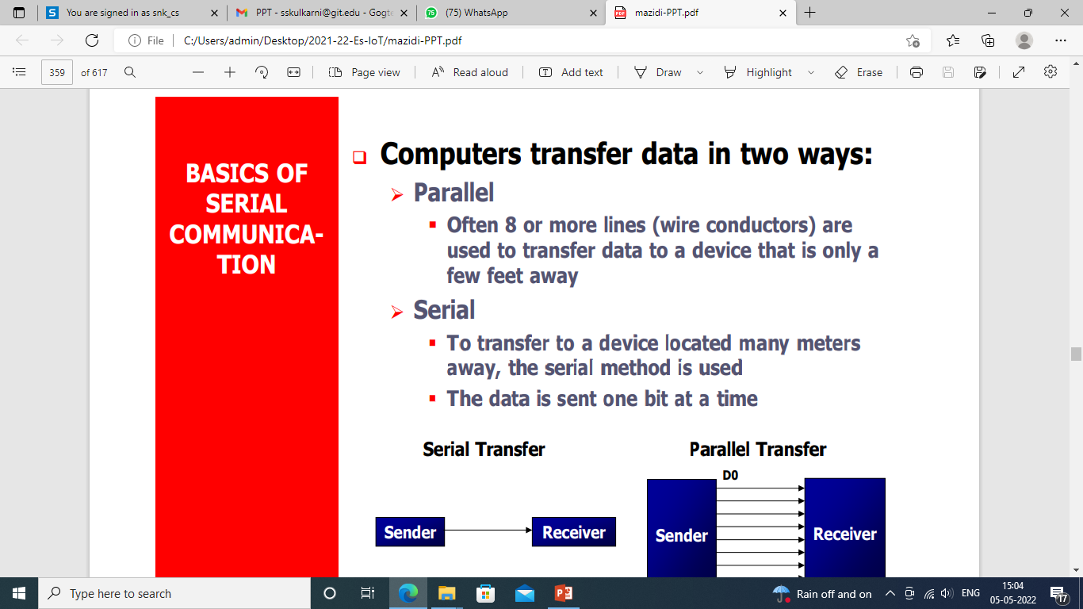
Basics of serial communication

Slide 3
cont’
At the transmitting end, the byte of data must be converted to serial bits using parallel-in-serial-out shift register.
At the receiving end, there is a serial-in-parallel-out shift register to receive the serial data and pack them into byte. When the distance is short, the digital signal can be transferred as it is on a simple wire and requires no modulation.
If data is to be transferred on the telephone line, it must be converted from 0s and 1s to audio tones. This conversion is performed by a device called a modem, “Modulator/demodulator”.

Slide 4
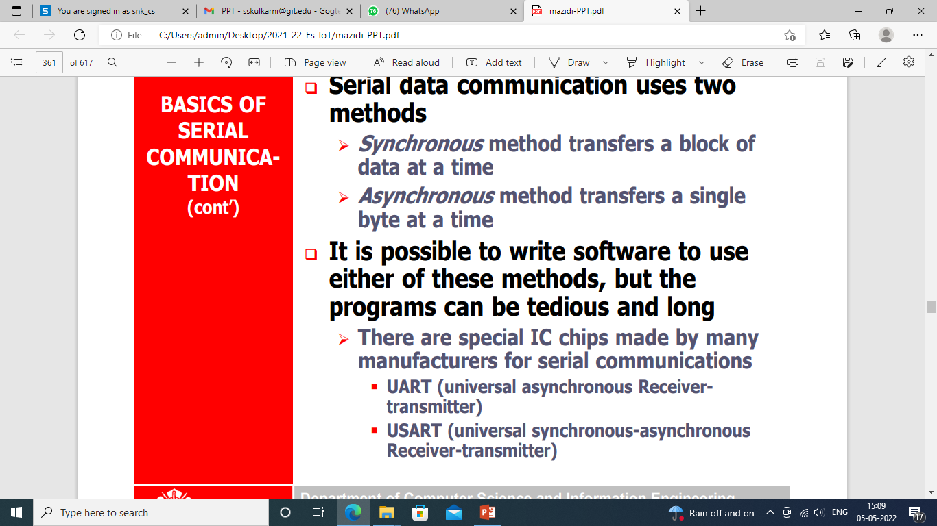

Slide 5
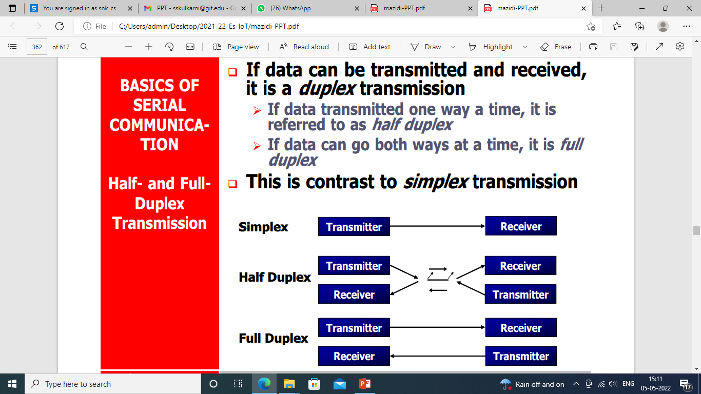

Slide 6
Protocol is a set of rules agreed by both the sender and receiver on,
How the data is packed
How many bits constitute a character
When the data begins and ends
Asynchronous serial data communication is widely used for character-oriented transmissions;
Each character is placed in between start and stop bits, this is called framing .
Block-oriented data transfers use the synchronous method.
The start bit is always one bit, but the stop bit can be one or two bits

Slide 7
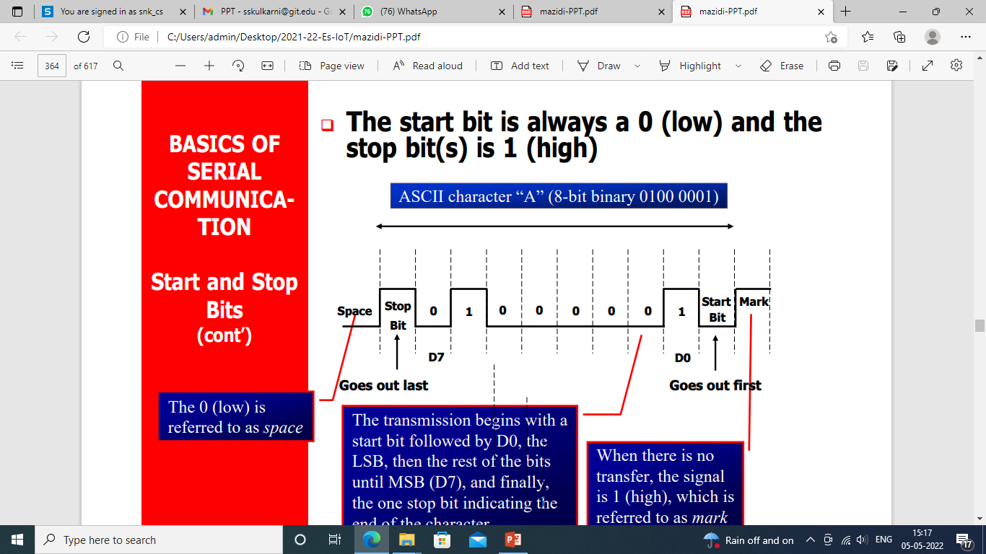

Slide 8
The rate of data transfer in serial data communication is stated in bps (bits per second).
Another widely used terminology for bps is baud rate. It is modem terminology and is defined as the number of signal changes per second. In modems, there are occasions when a single change of signal transfers several bits of data.
As s far as the conductor wire is concerned, the baud rate and bps are the same, and we use the terms interchangeably.

Slide 9
The data transfer rate of given computer system depends on communication ports incorporated into that system.
IBM PC/XT could transfer data at the rate of 100 to 9600 bps.
Pentium-based PCs transfer data at rates as high as 56K bps.
In asynchronous serial data communication, the baud rate is limited to 100K bps.

Slide 10
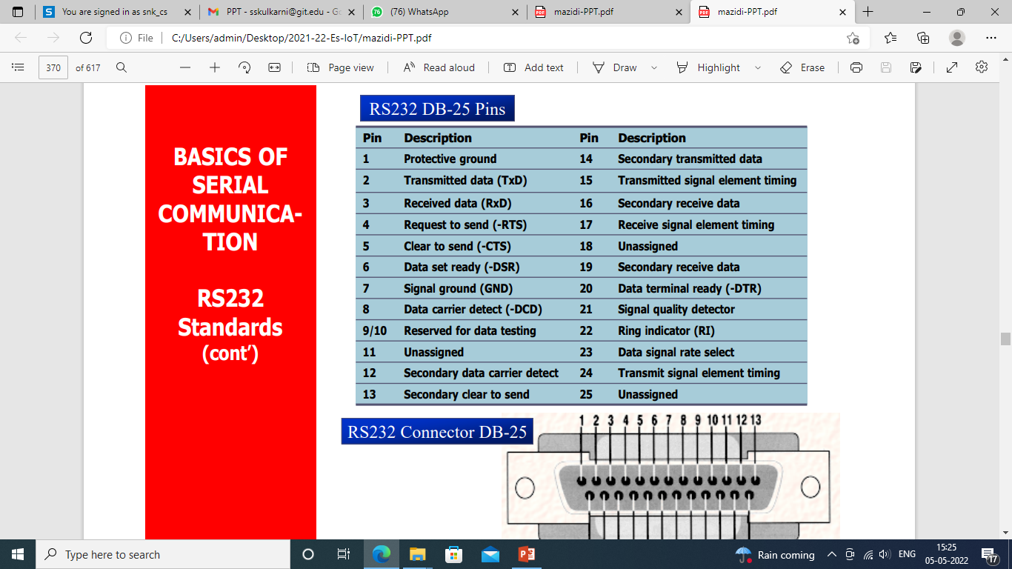

Slide 11
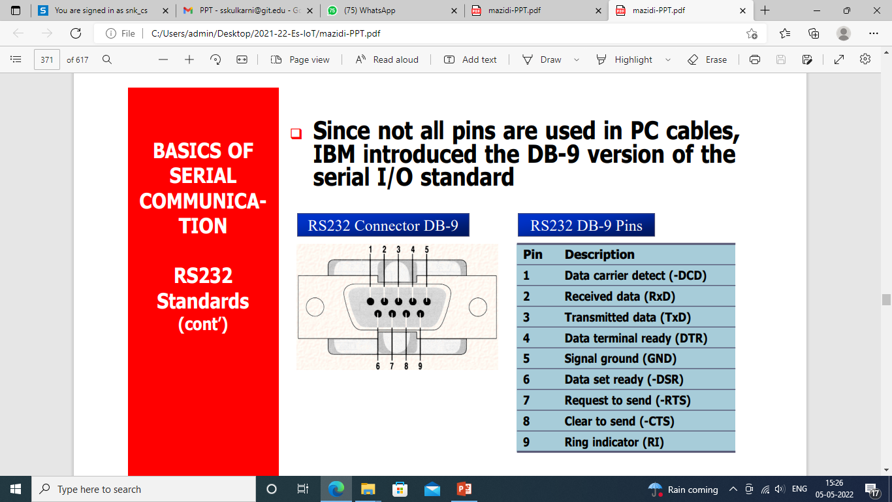

Slide 12
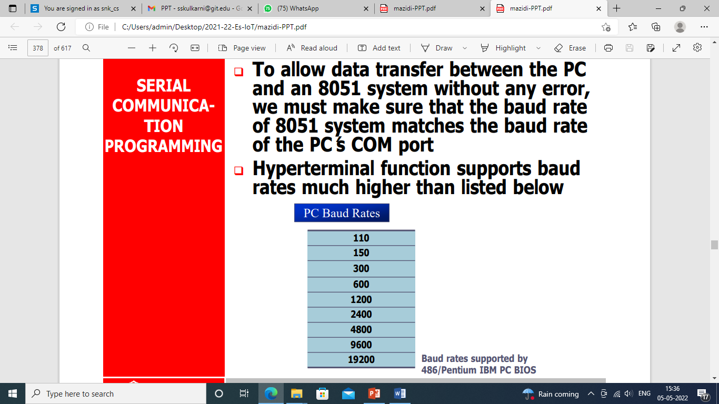

Slide 13
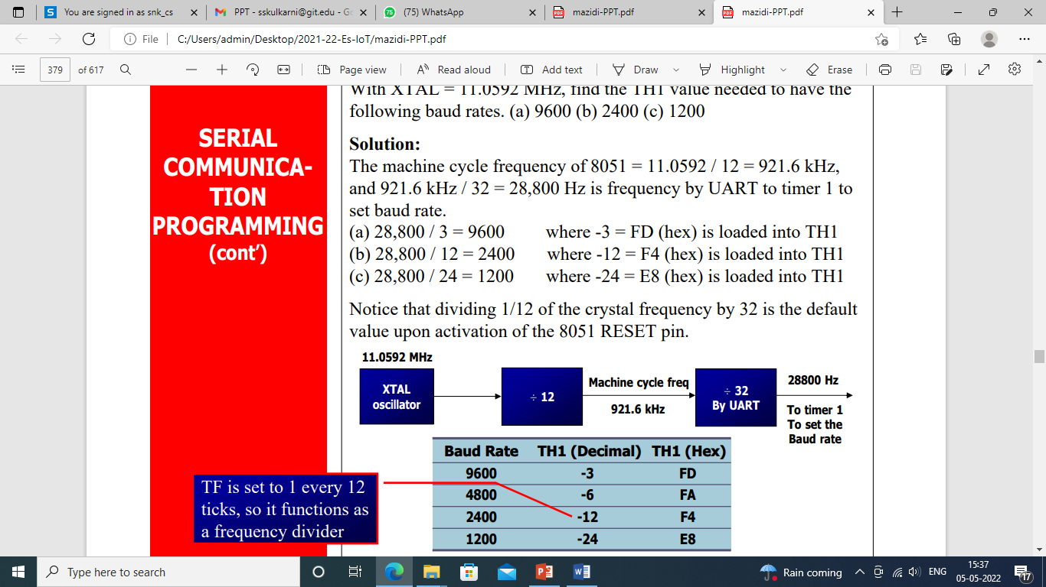

Slide 14
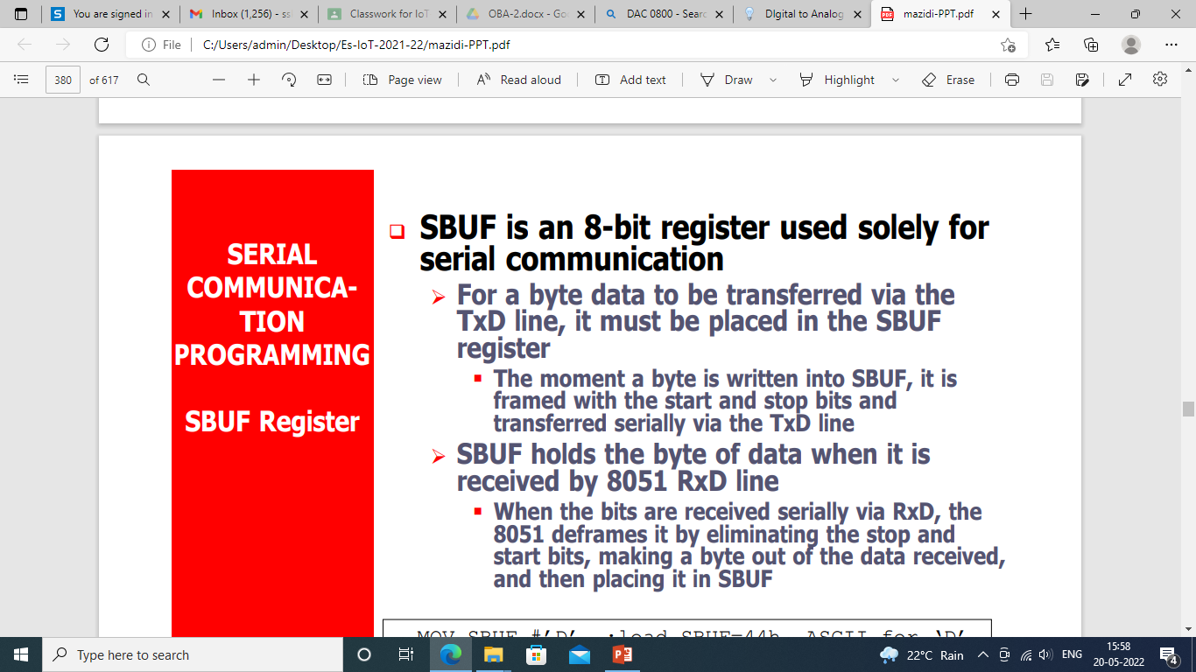

Slide 15
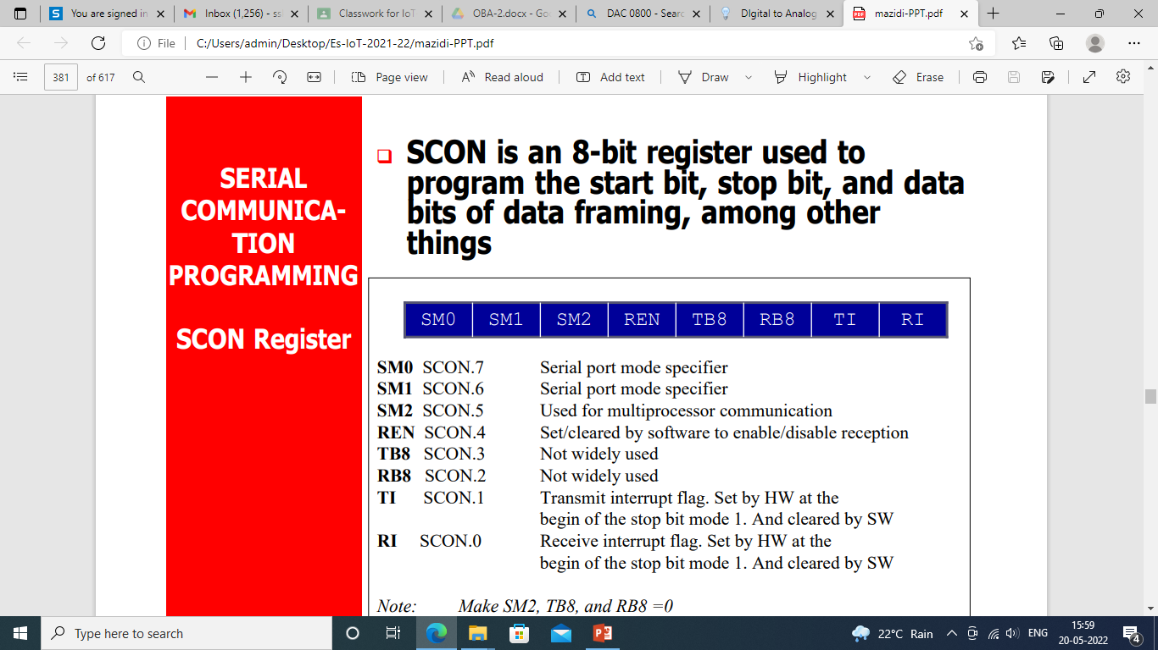

Slide 16
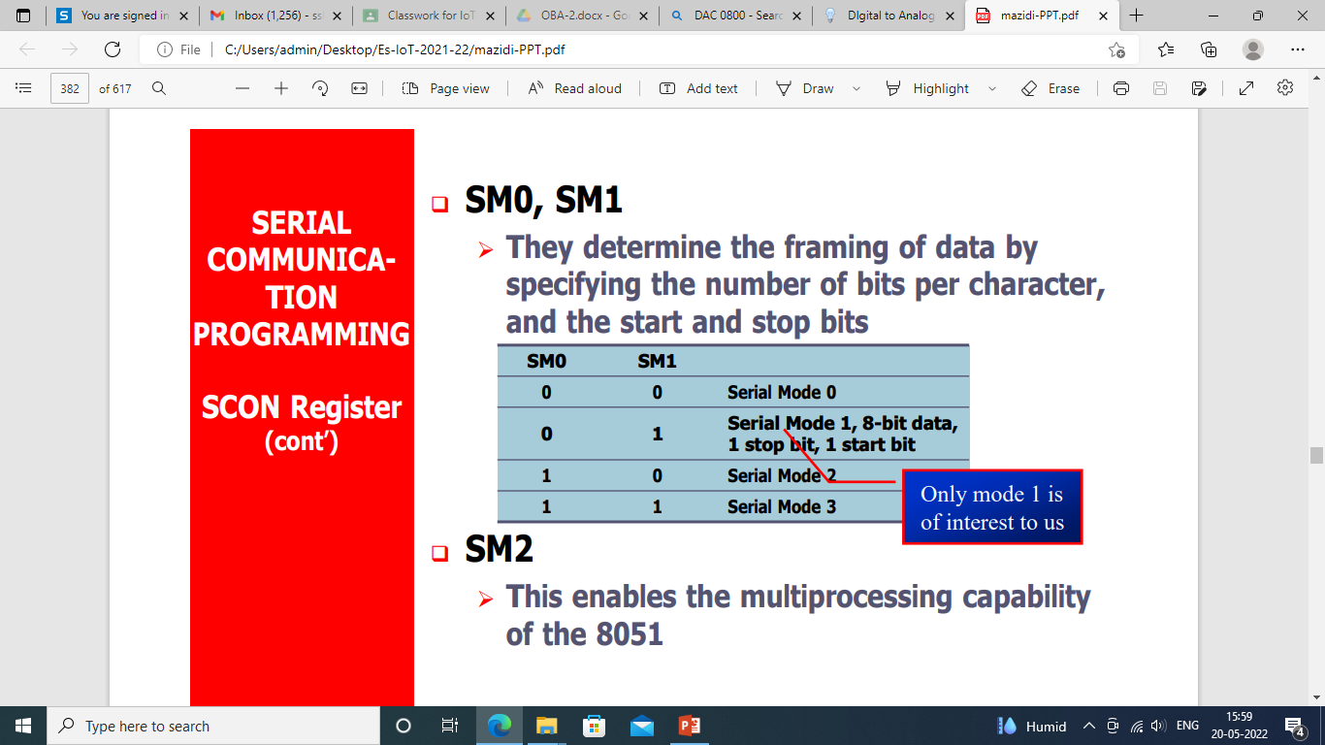

Slide 17
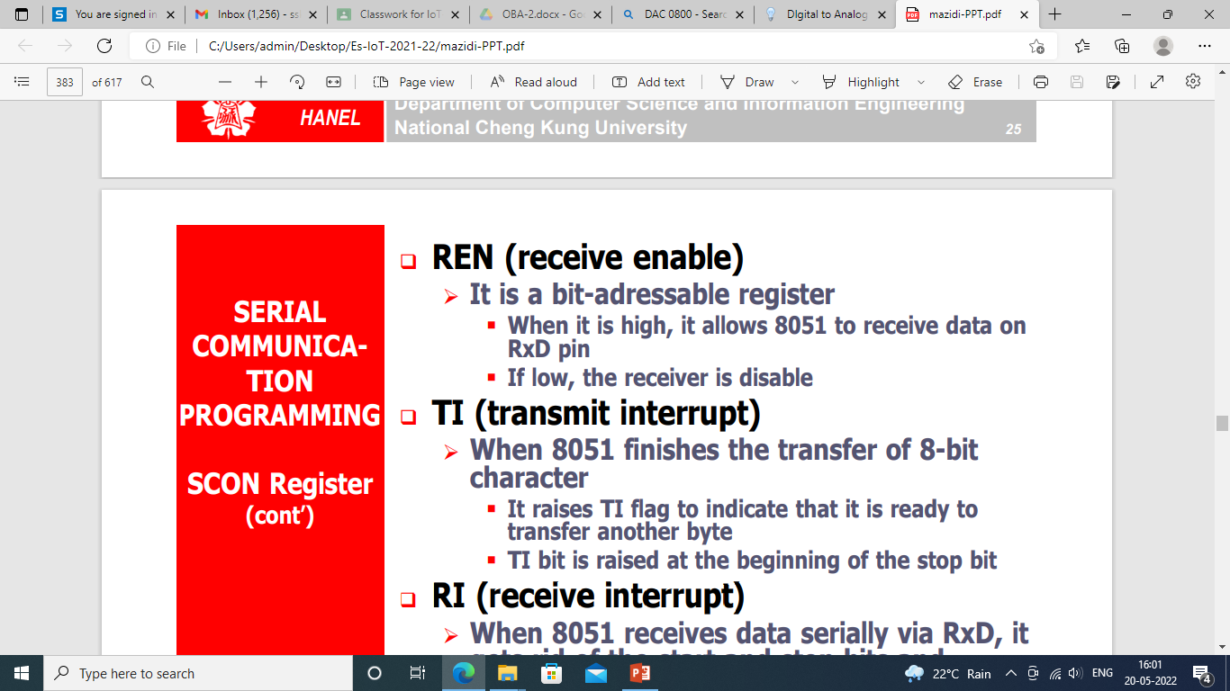

Slide 18
it gets rid of the start and stop bits and places the byte in SBUF register.
It raises the RI flag bit to indicate that a byte has been received and should be picked up before it is lost.
RI is raised halfway through the stop bit.

Slide 19
In programming the 8051 to transfer character bytes serially
1. TMOD register is loaded with the value 20H, indicating the use of timer 1 in mode 2 (8-bit auto-reload) to set baud rate.
2. The TH1 is loaded with one of the values to set baud rate for serial data transfer.
3. The SCON register is loaded with the value 50H, indicating serial mode 1, where an 8- bit data is framed with start and stop bits.
4. TR1 is set to 1 to start timer 1.
5. TI is cleared by CLR TI instruction.
6. The character byte to be transferred serially is written into SBUF register.
7. The TI flag bit is monitored with the use of instruction JNB TI,xx to see if the character has been transferred completely.
8. To transfer the next byte, go to step 5

Slide 20
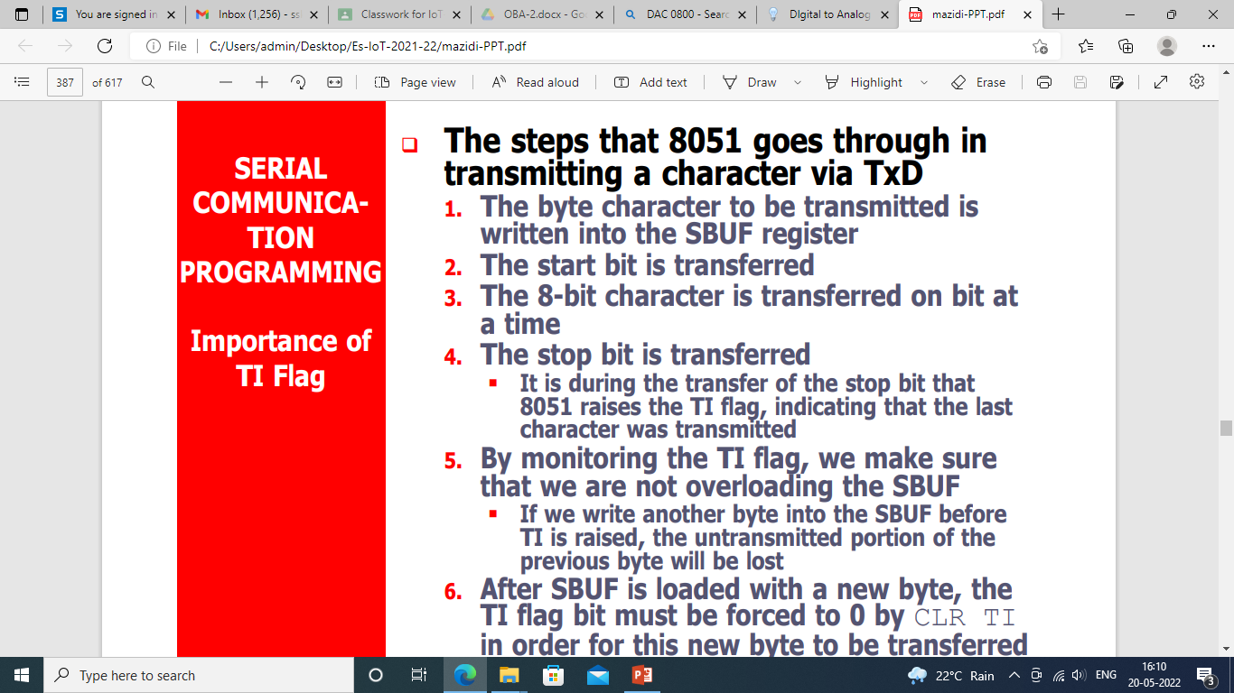

Slide 21
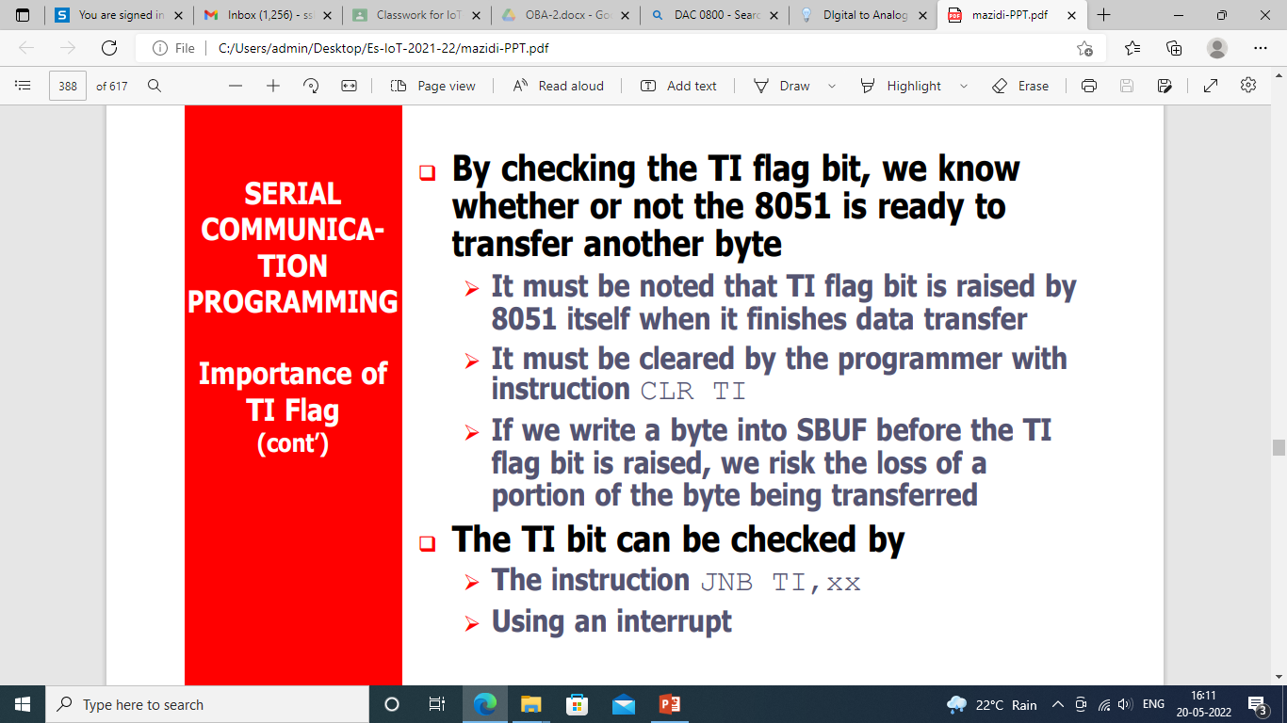

Slide 22
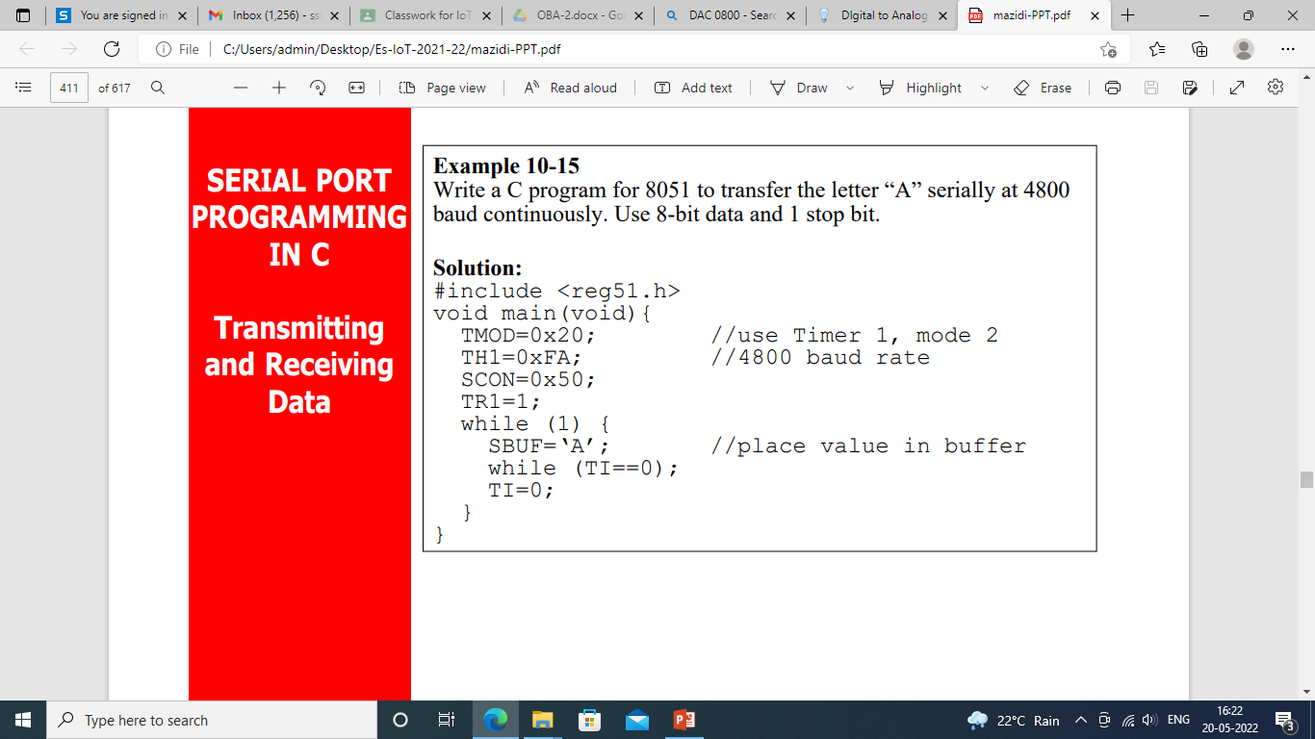

Slide 23
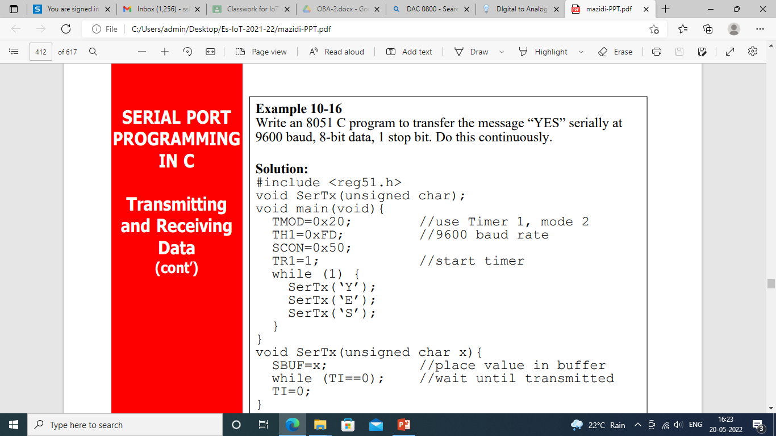

Slide 24
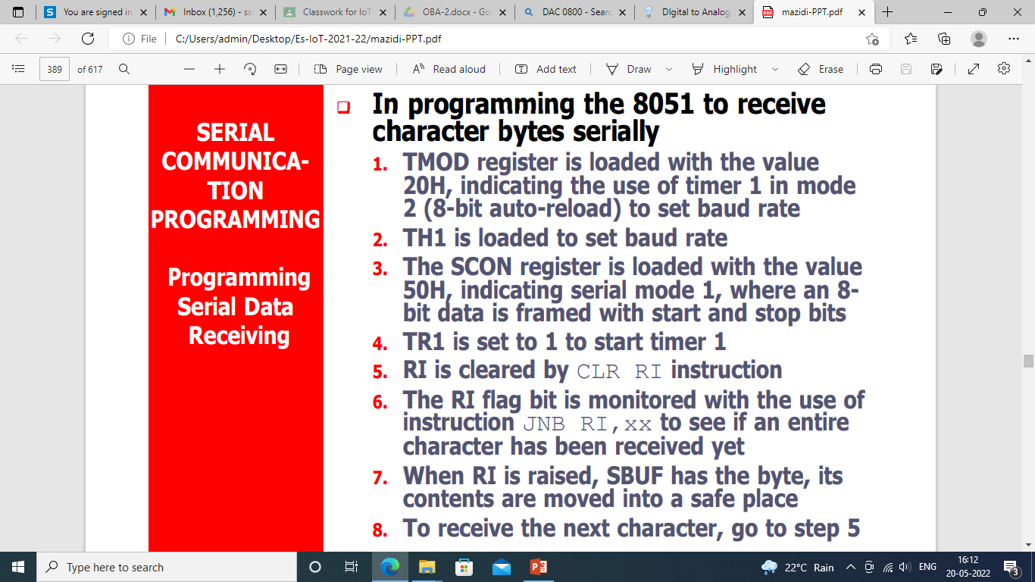

Slide 25
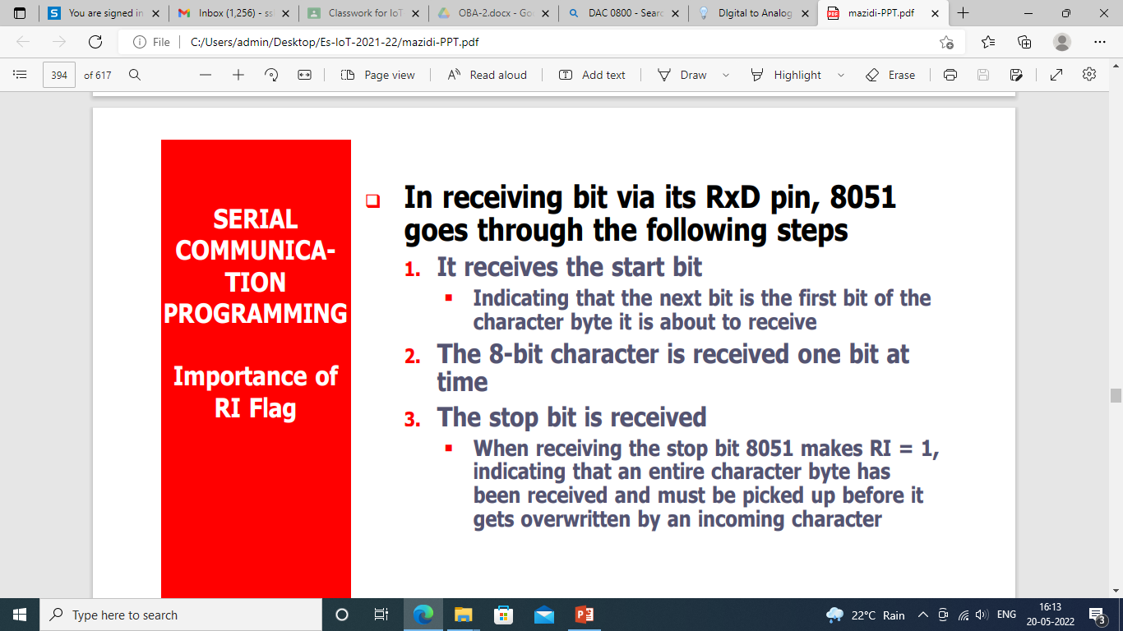

Slide 26
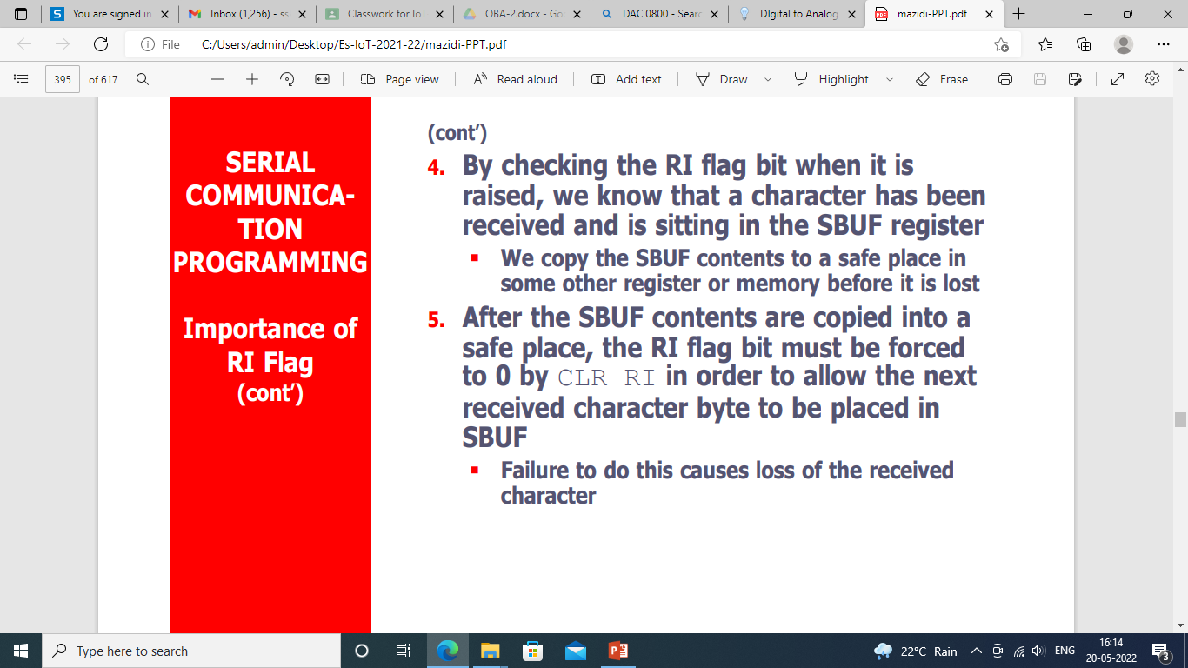

Slide 27


Slide 28
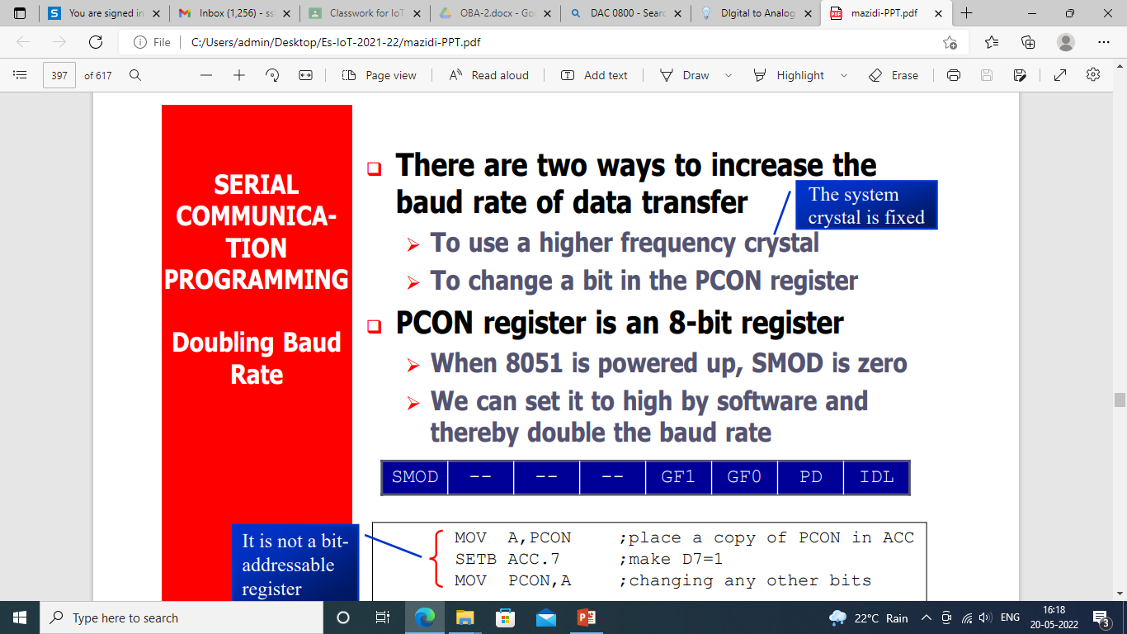

Slide 29
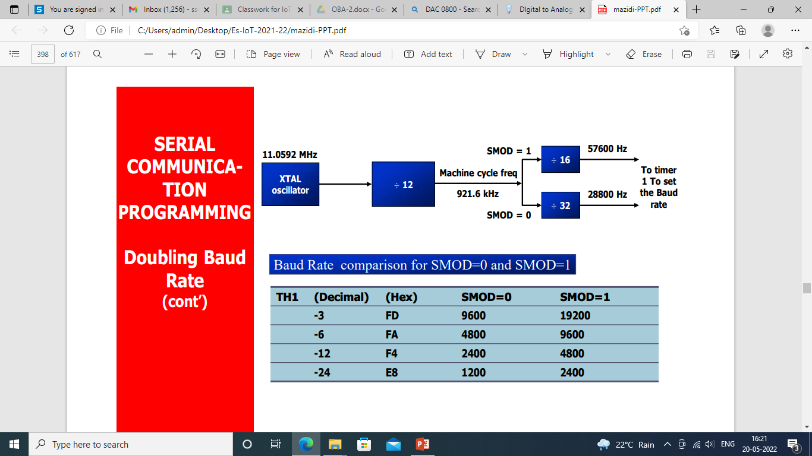

Slide 30
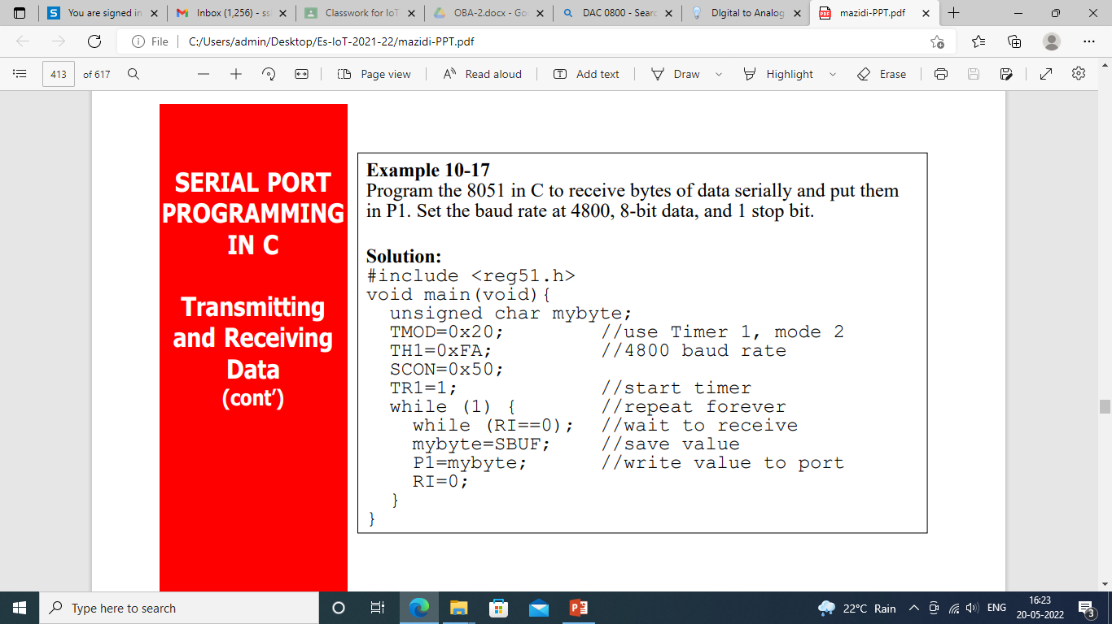

Slide 32
Interfacing of LCD
A liquid crystal display or LCD draws its definition from its name itself. It is a combination of two states of matter, the solid and the liquid.
LCD uses a liquid crystal to produce a visible image. Liquid crystal displays are super-thin technology display screens that are generally used in laptop computer screens, TVs, cell phones, and portable video games.
LCD’s technologies allow displays to be much thinner when compared to a cathode ray tube (CRT) technology.

Slide 33
Advantages
LCD’s consumes less amount of power compared to CRT and LED
LCD’s are consist of some microwatts for display in comparison to some mill watts for LED’s
LCDs are of low cost
Provides excellent contrast
LCD’s are thinner and lighter when compared to cathode-ray tube and LED
Disadvantages
Require additional light sources
Range of temperature is limited for operation
Low reliability
Speed is very low
LCD’s need an AC drive

Slide 34
LCD is very commonly used electronic display module and having a wide range of applications such as calculators, laptops, mobile phones etc.
16×2 character is very basic module which is commonly used in electronics devices and projects.
It can display 2 lines of 16 characters.
Each character is displayed using 5×7 or 5×10 pixel matrix.
LCD can be interfaced with microcontroller in 4 Bit or 8 Bit mode.
These differs in how data is sent to LCD.
In 8 bit mode to write a character, 8 bit ASCII data is sent through the data lines D0 – D7 and data strobe is given through EN of the LCD.
LCD commands which are also 8 bit are written to LCD in similar way.

Slide 35
4 Bit Mode uses only 4 data lines D4 – D7.
In this mode 8 bit character ASCII data and command data are divided into two parts and send sequentially through data lines.
The idea of 4 bit communication is used save pins of microcontroller.
4 bit communication is a bit slower than 8 bit communication but this speed difference can be neglected since LCDs are slow speed devices.
Thus 4 bit mode data transfer is most commonly used.

Slide 36
Lcd4_Init () : These function will initialize the LCD module which is connected to pins defined by following bit addressable variables.
//LCD Module Connections
sbit RS(Register Select) = P2^7;
sbit EN (Enable) = P2^6;
sbit R/W(Read/Write) = P2.5;
sbit Data D4 = P2^0;
sbit Data D5 = P2^1;
sbit Data D6 = P2^2;
sbit Data D7 = P2^3;
Data D0, D1, D2, D3 = No connection
//End LCD Module Connections

Slide 37
RS= 0 for sending Command to the LCD
RS=1 for sending Data to the LCD
R/W= 0 for reading from the LCD
R/W=1 for writing to the LCD
EN=0 for disabling the LCD
EN=1 for enabling the LCD

Slide 38
Lcd4_Clear() : These functions will clear the LCD screen when interfaced with 8051 in 4 bit mode.
Lcd4_Set_Cursor() : These functions are used to set the cursor position on the LCD screen. By using this function we can change the position of character and string displayed by the following functions.
Lcd4_Write_Char() : These functions are used to write a character to the LCD screen.

Slide 39
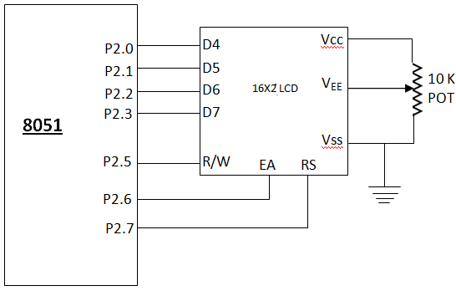
Lcd4_Shift_Left() : These functions are used to shift display left without changing the data in display RAM.
Lcd4_Shift_Right() : These functions are used to shift display right without changing the data in display RAM.

Slide 40
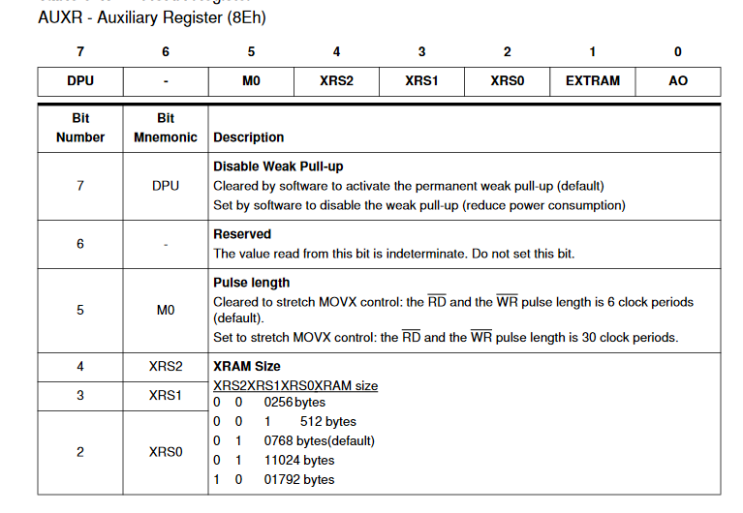

Slide 41
#include "at89c51ed2.h"
#include <intrins.h>
// LCD FUNCTION PROTOTYPE
void lcd_init(void);
void lcd_comm(void);
void lcd_data(void);
unsigned char xdata arr[16]={“GITCSE"};
unsigned char temp1=0x00;
unsigned char temp2;
unsigned int i=0;

Slide 42
void main(void)
{
AUXR = 0x10; // Accessing Full XRAM
lcd_init();
temp1 = 0x80; // To display from the first line
lcd_comm(); // Command writing
for(i=0;i<6;i++)
{
temp2 = arr[i];
lcd_data(); // Data writing
}
while(1)
{
}
}

Slide 43
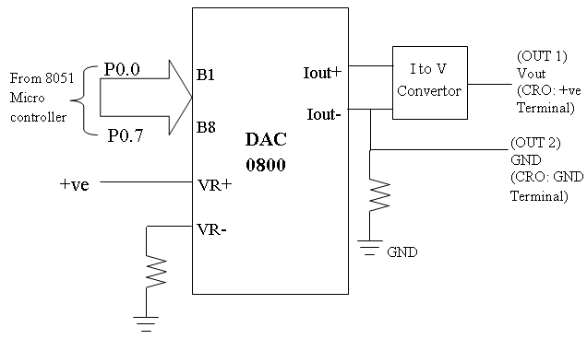
Digital To Analog Converter
0800 is a 8-bit high speed current output digital to analog converter. DAC 0800 is used to convert the digital data into analog signal. Digital data from any port is given to DAC input.

Slide 44
Code For Square wave
#include “at89c5ed2.h”
void delay(void);
void main ()
{
while(1)
{
P0 = 0x00; // program outputs 0 and 0xff alternatively to port P0 with a delay delay();
P0 = 0xff;
delay();
}
}
void delay(void) // function to generate delay
{
int i;
for(i=0;i<=300;i++);
}

Slide 45
Code For Triangular wave
#include “at89c51ed2.h
unsigned char count;
void main ()
{
while(1)
{
for(count=0;count!=0xff;count++)
{ P0=count;
}
for(count=0xff; count>0;count--)
{
P0=count;
}
}
}

Slide 46
Examples
Interface DAC 0800 to generate the following waveforms:
Positive RAMP wave
Negative RAMP wave
Develop the algorithm and 8051 Embedded ‘C’ code for the same.

